Slide 1
Design and Performance Analysis of SRAM Cell in CMOS nm Technology SET Conference ID:- 220795
GUIDED BY- Dr. Arun Dev Dhar Dwivedi
Presented By:
Hitesh Paliwal 22MVD0128
Pratyush Parashar 22MVD0129
Sachindra Mane 22MVD0140

Slide 2
Table of Content
6T cell array
SRAM Sizing Constraint
SRAM operation
Graphs
8T SRAM cell array
SNM Read
SRAM Static Noise Margin analysis
Comparison of SRAM cells
Refrences

Slide 3
1. 6T SRAM Cell
BL
BLB
WL
WL
M3
M6
M2
M5
QB
Q
M1
M4

Slide 4
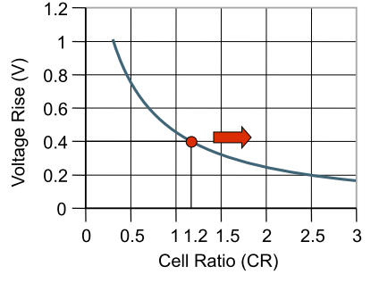
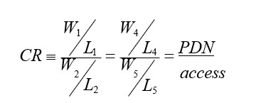

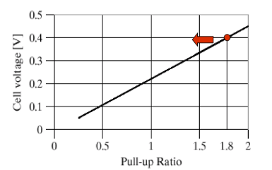
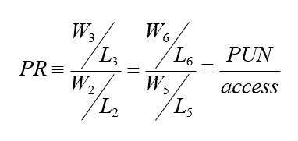
2. SRAM Sizing Constraints
Read Constraint
^{K}PDN ^{> K}access ^{> K}PUN
Write Constraint
^{K}access^{> K}PUN

Slide 5
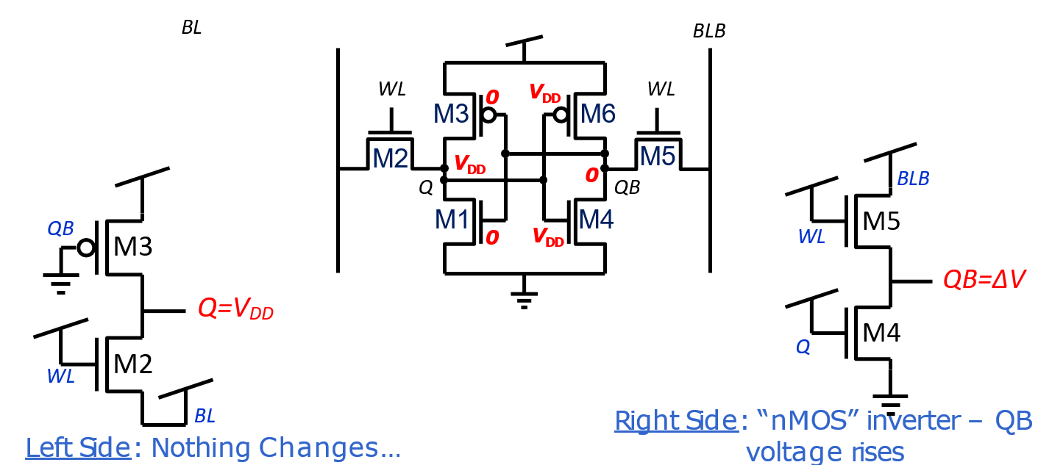
3. SRAM Operation: i. Read

Slide 6
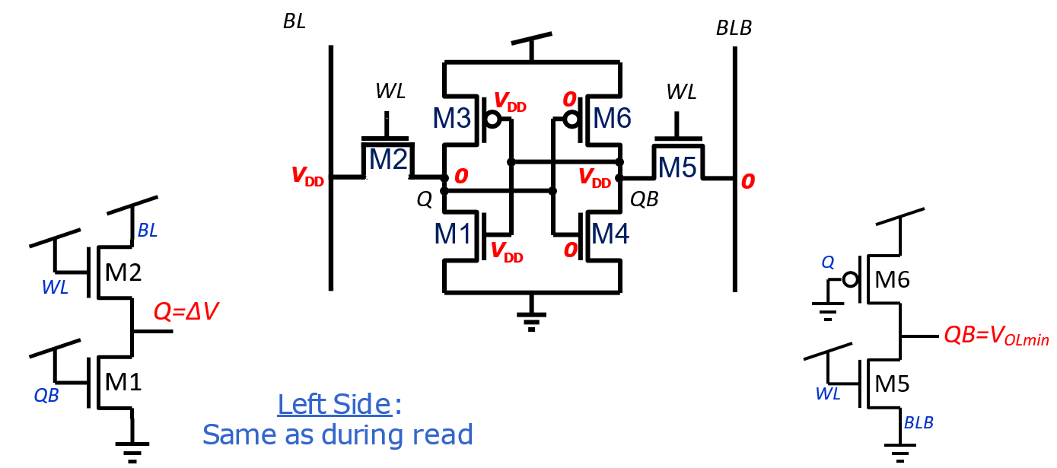
ii. Write

Slide 7
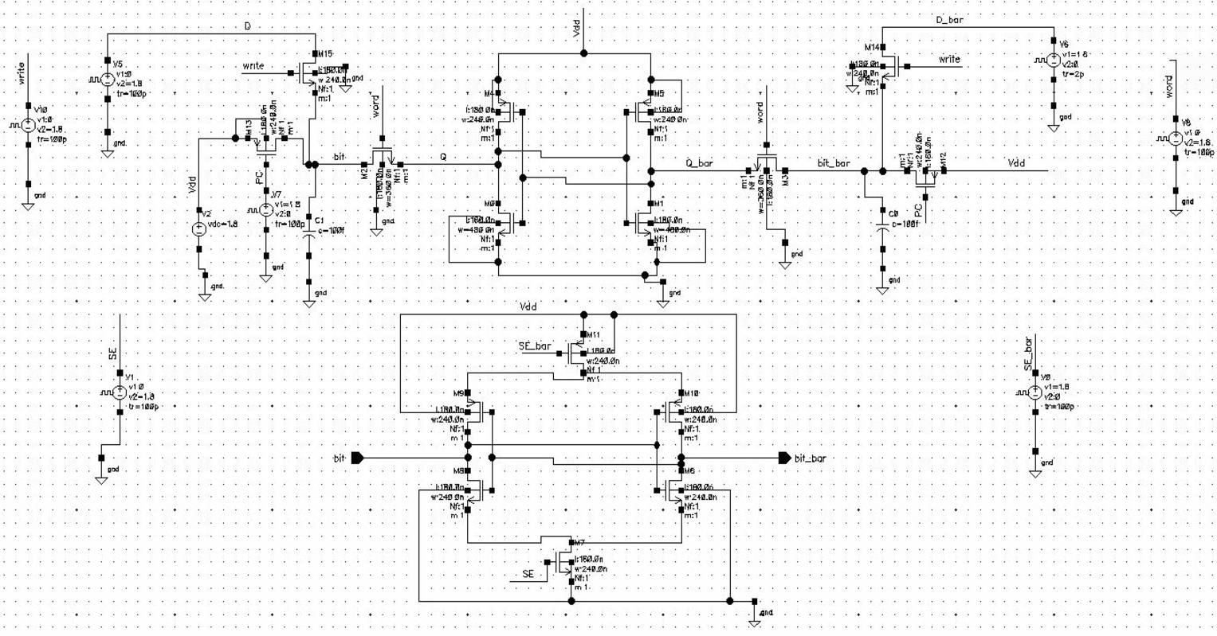
Schematic Diagram

Slide 8
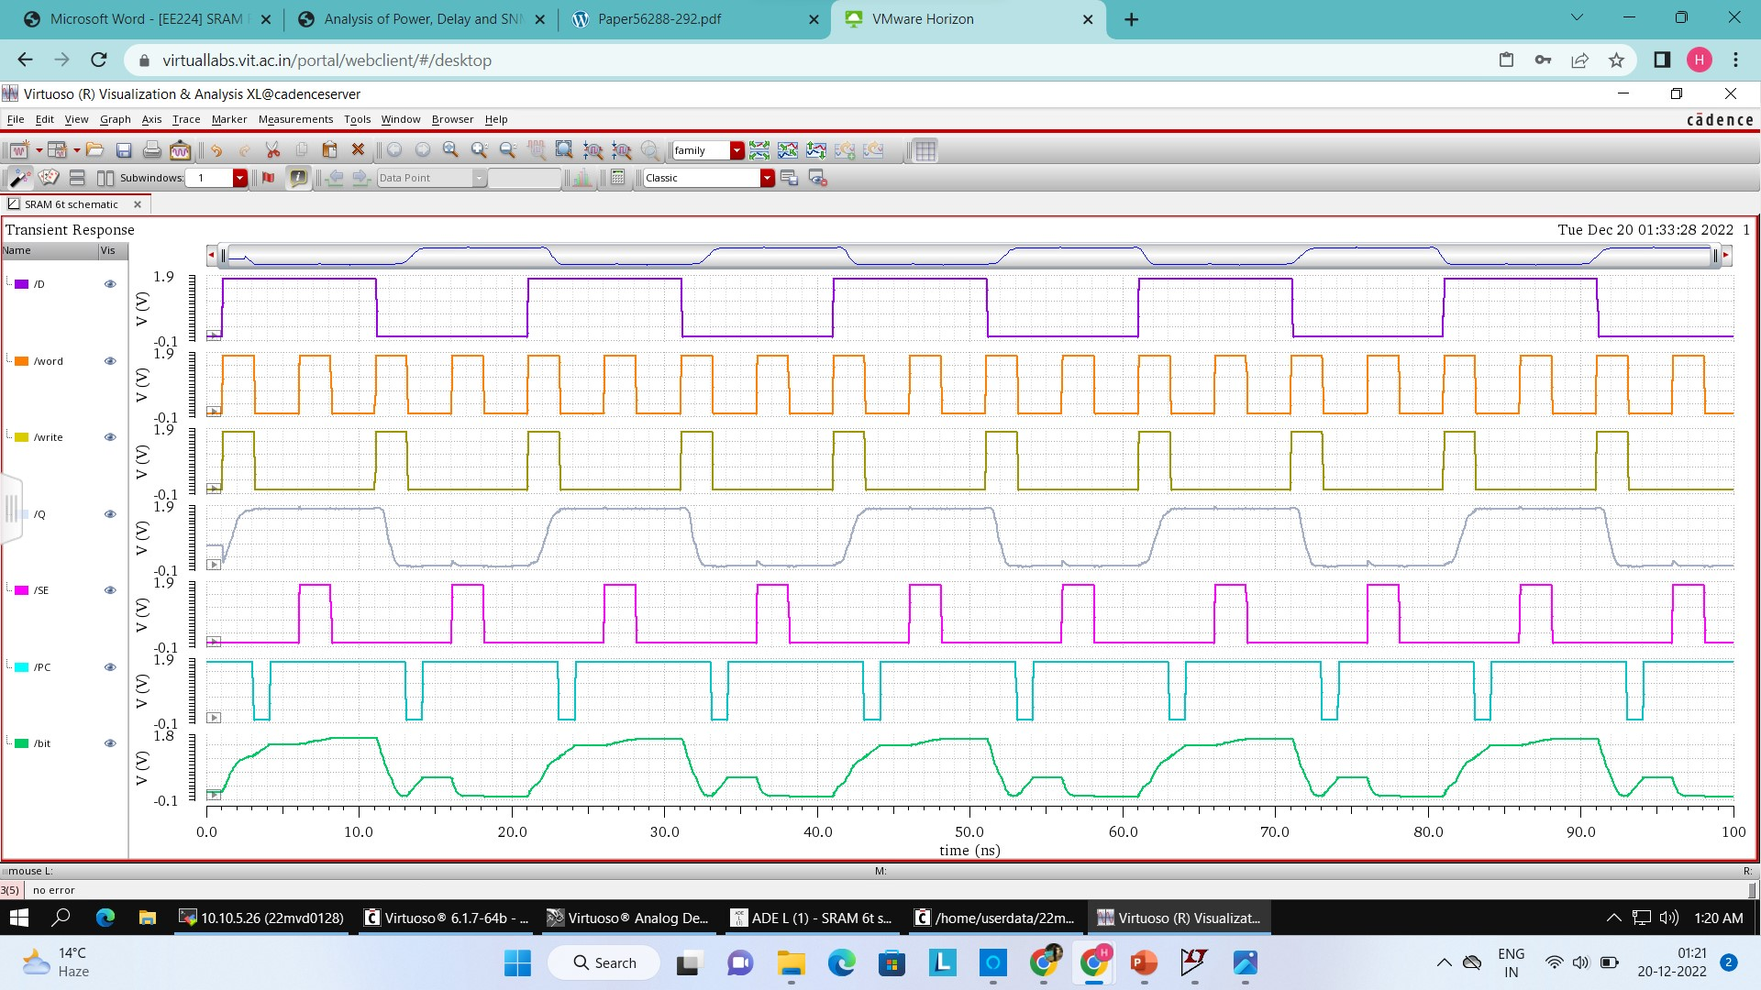
4. Graphs: (i)Read Operation

Slide 9
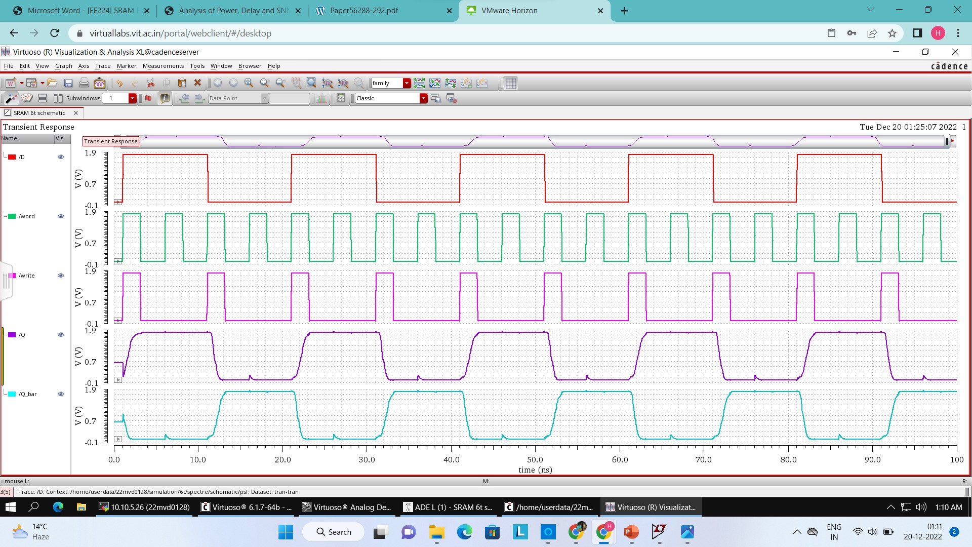
(ii)Write Operation

Slide 10
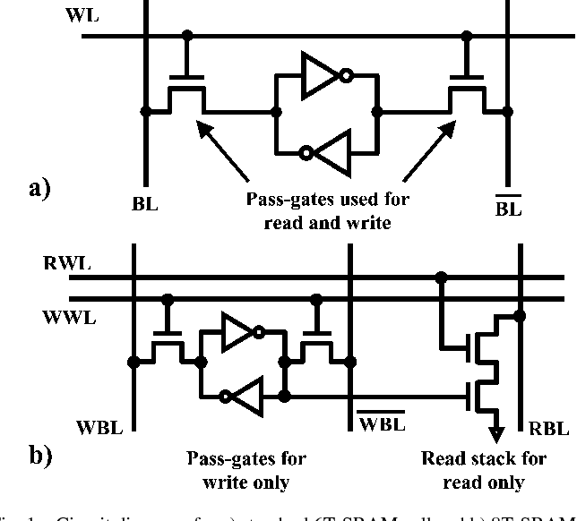
5. 8T SRAM Basics

Slide 11
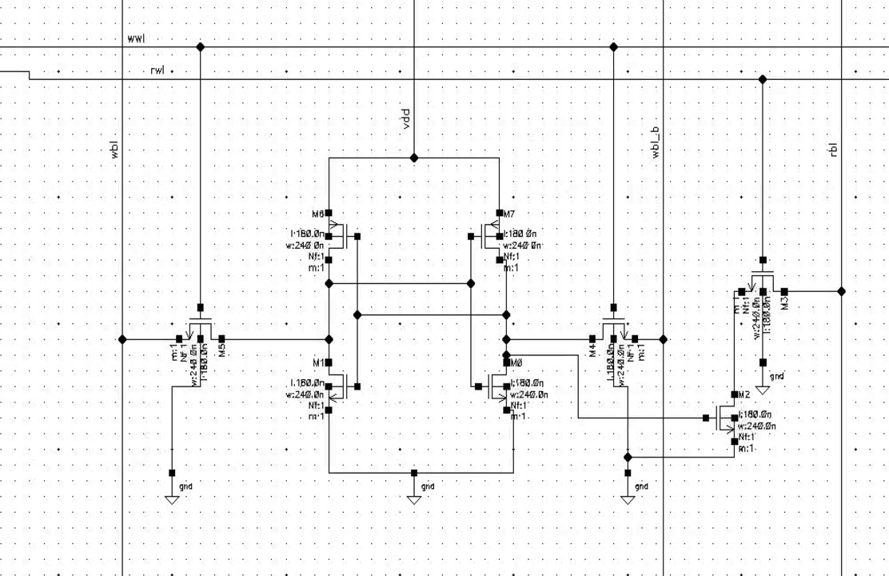
8T SRAM Schematic

Slide 12
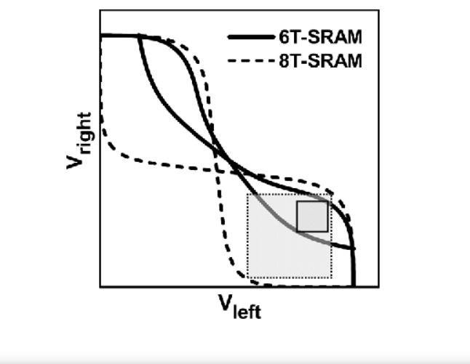
6. SNM Read

Slide 13
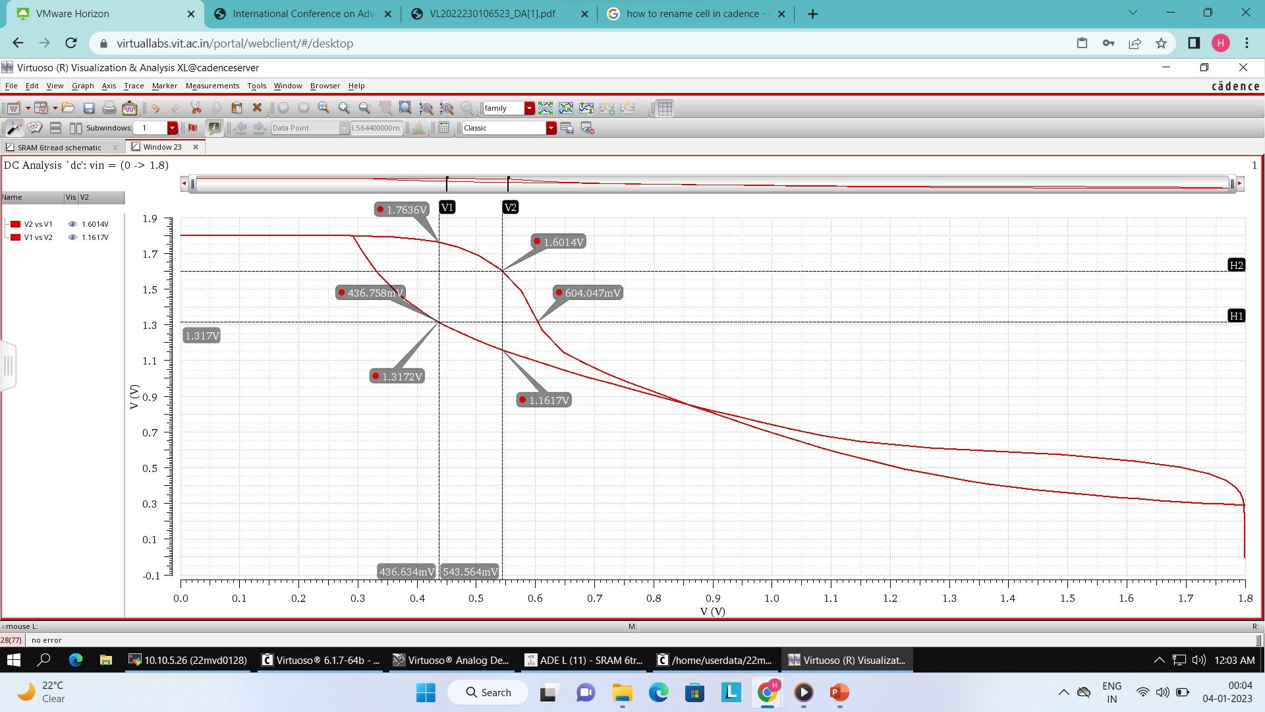
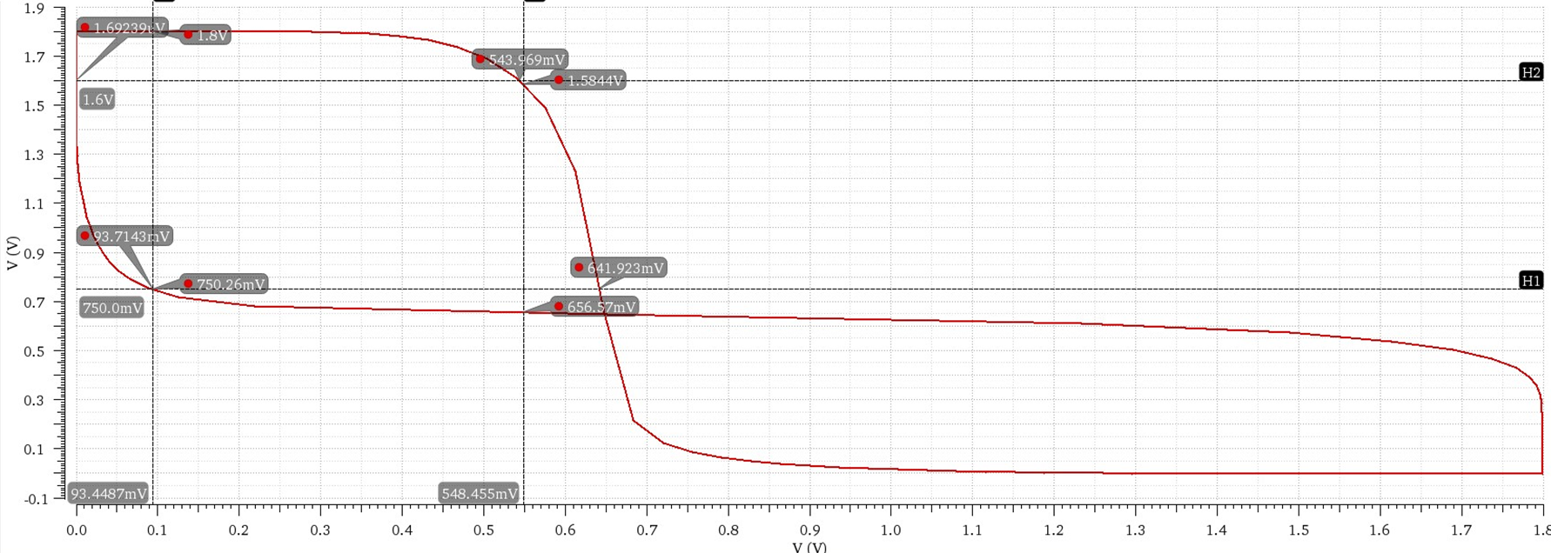
7. SRAM Static Noise Margin (SNM) Analysis
Read SNM :-
180nm
6T SRAM cell
8T SRAM cell

Slide 14
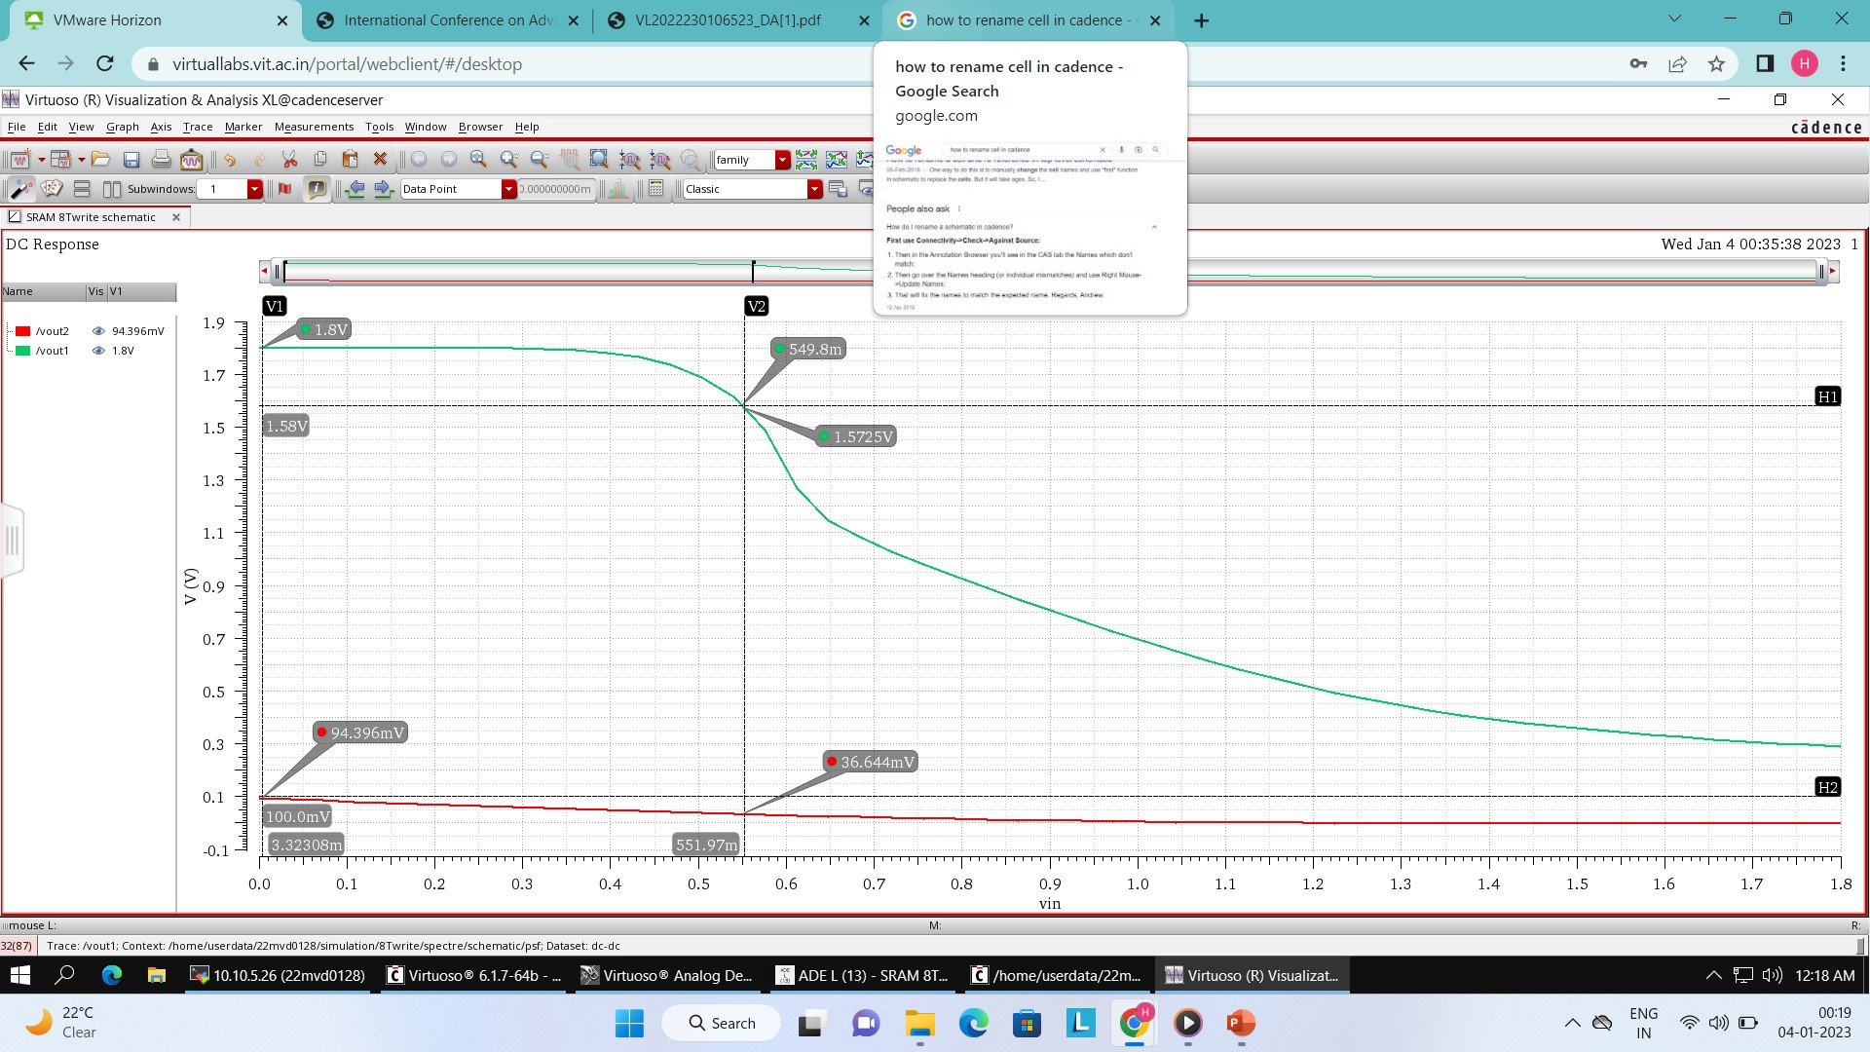
Write SNM :-
180nm
6T SRAM cell
8T SRAM cell

Slide 15
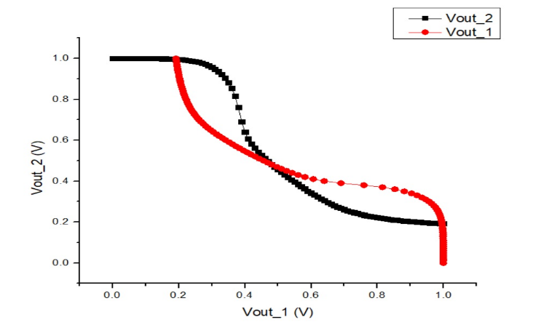
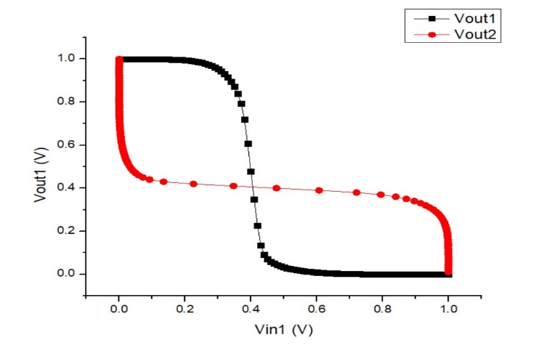
Read SNM :-
50nm
6T SRAM cell
8T SRAM cell

Slide 16
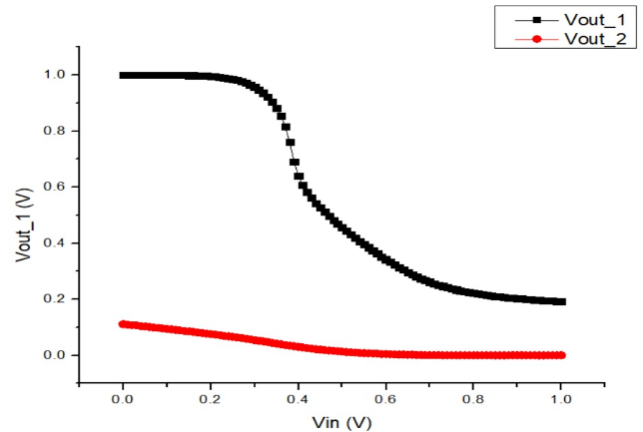
Write SNM :-
50nm
6T SRAM cell
8T SRAM cell

Slide 17
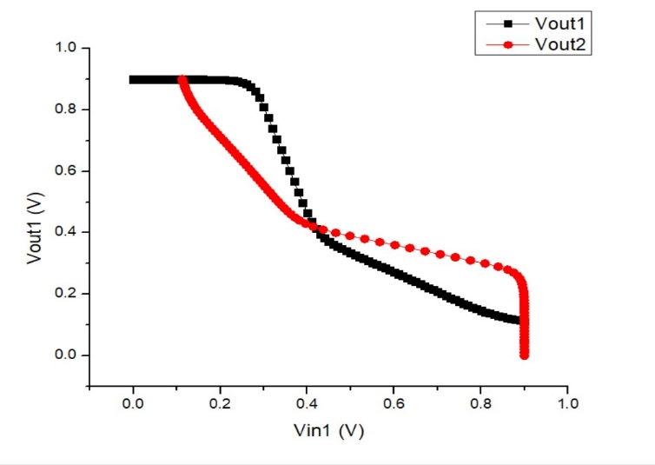
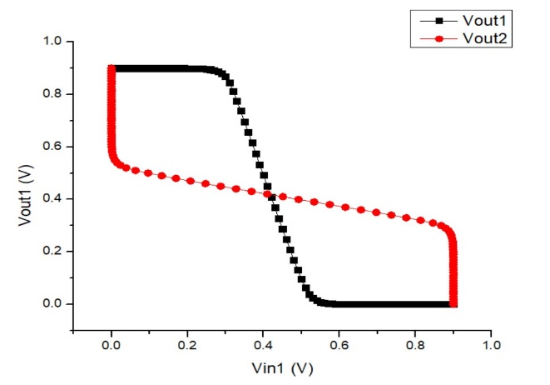
Read SNM :-
16nm
6T SRAM cell
8T SRAM cell

Slide 18
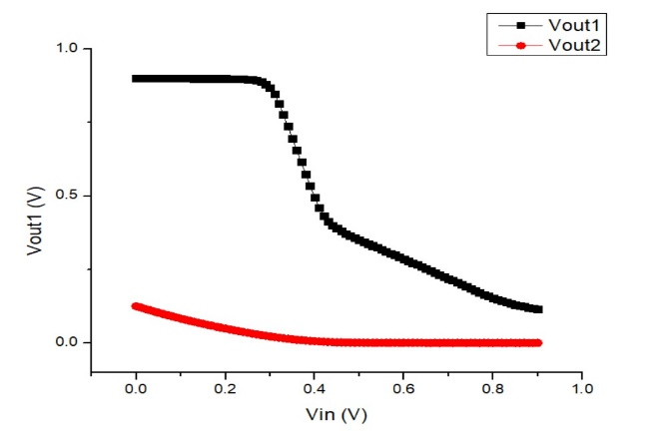
Write SNM :-
16nm
6T SRAM cell
8T SRAM cell

Slide 19
8. Comparison of SRAM cells
TECHNOLOGY NODE | TOPOLOGIES | SNM_R | SNM_W
180nm | 6T | 284mV | 1.478V
 | 8T | 942mV | 1.478V
50nm | 6T | 138mV | 465mV
 | 8T | 381mV | 465mV
16nm | 6T | 125mV | 391mV
 | 8T | 338mV | 391mV

Slide 20
9. References
S. Mutum and K. Mondal, "Comparative Performance Analysis of 6T SRAM cell in 180nm and 90nm Technologies," 2021 Asian Conference on Innovation in Technology (ASIANCON), PUNE, India, 2021, pp. 1-4, doi: 10.1109/ASIANCON51346.2021.9544733.
Ishibashi, Koichiro and Kenichi Osada. “Low power and reliable SRAM memory cell and array design.” (2011).
K. Anami, M. Yoshimoto, H. Shinohara, Y. Hirata and T.Nakano, "Design considerations of a static memory cell", IEEE J.Solid-State Circuits, vol. SC-18, no. 4, pp. 414-418, Aug. 1983
A. Agal, Pardeep, B. Krishan, 6T SRAM Cell: Design And Analysis, Int. J. Eng. Res. Appl. 4 (2014) 574–577
D. Suneja, N. Chaturvedi and S. Gurunarayanan, "A comparative analysis of read/write assist techniques on performance & margin in 6T SRAM cell design," 2017 International Conference on Computer, Communications and Electronics (Comptelix), Jaipur, India, 2017, pp. 659-664, doi: 10.1109/COMPTELIX.2017.8004051
P. N. V. Kiran and N. Saxena, "Design and analysis of different types SRAM cell topologies," 2015 2nd International Conference on Electronics and Communication Systems (ICECS), Coimbatore, India, 2015, pp. 1060-1065, doi: 10.1109/ECS.2015.7124742.

Slide 21
THANK YOU

